Slide 1

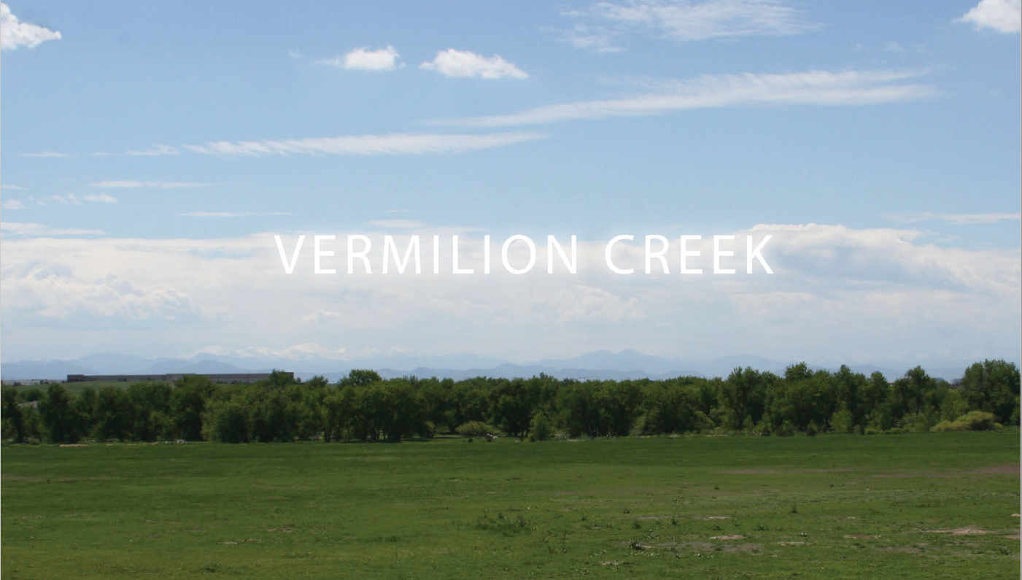


Slide 2
Project team
Applicant- Mountain Plains Investment Corp (Fetters Family)
Development Manager- Jason A Monforton PE
Planning and Landscape Architecture- Consilium Design
Civil Engineer- Dewberry
Surveyor- Altura Land Consultants

Slide 3
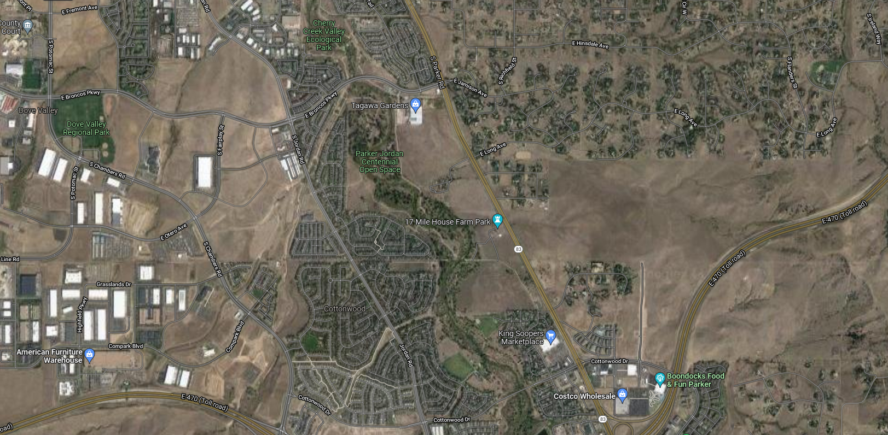

Slide 4
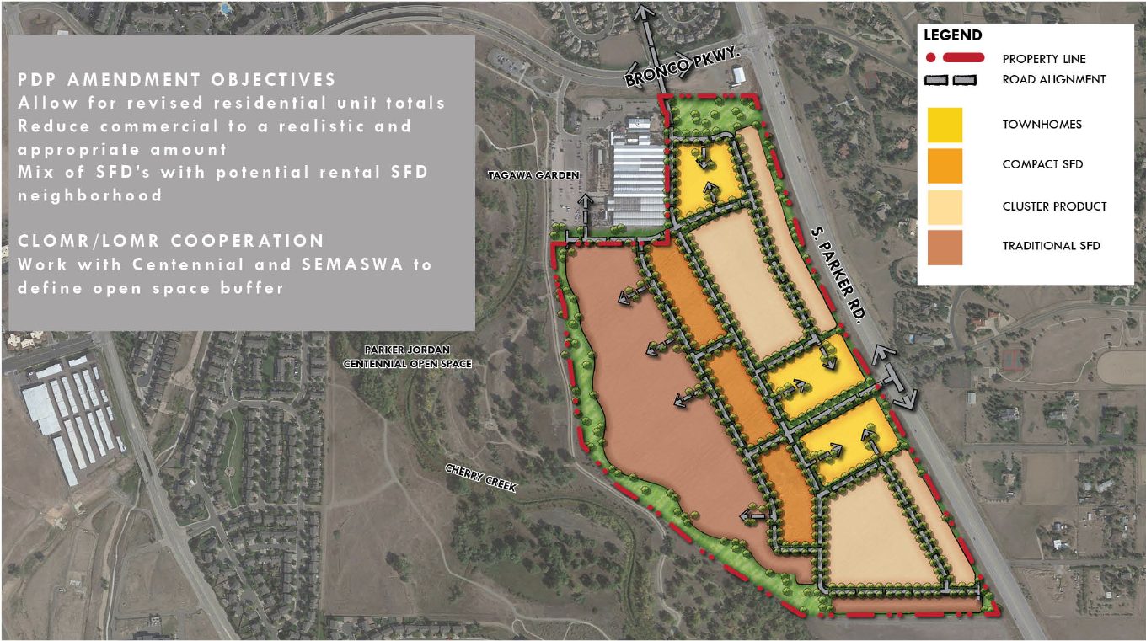
Preliminary Unit Yield
Single Family Detached (Traditional) 114 lots
Single Family Detached (Small lot) 82 lots
Single Family Detached (Cluster) 198 lots
Single Family Attached (Townhomes) 207 lots
Total 601 lots

Slide 5
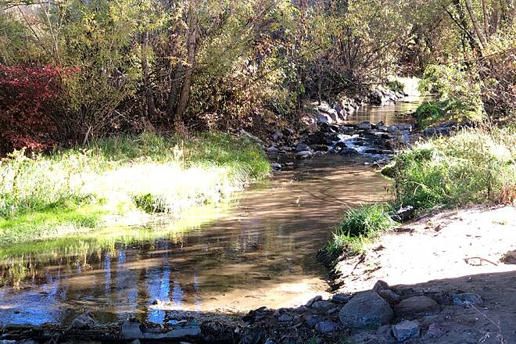
Site Plan General details
City of Centennial approval required
Water and sanitary sewer provide by ACWWA.
Storm Runoff Detention per SEMSWA requirements
Floodplain Modifications Study in process (no detrimental effects to adjacent, downstream, or upstream, properties
Approximately 600 single family residential units
Approximately 2 acres of mixed-use area (specific user to be determined)
Proposing to develop the site in 3 phases.

Slide 6
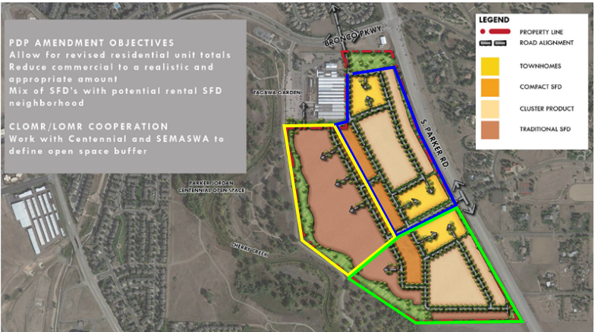
Phasing
Phase I – Northeast portion of the site between Parker Road and proposed Cherokee trail.
Phase II – Western edge of site along Cherry Creek portion of the site between Parker Road and proposed Cherokee trail.
Phase III –Southern portion of the site between Parker Road and Cherry Creek near the 17 mile house property.

Slide 7
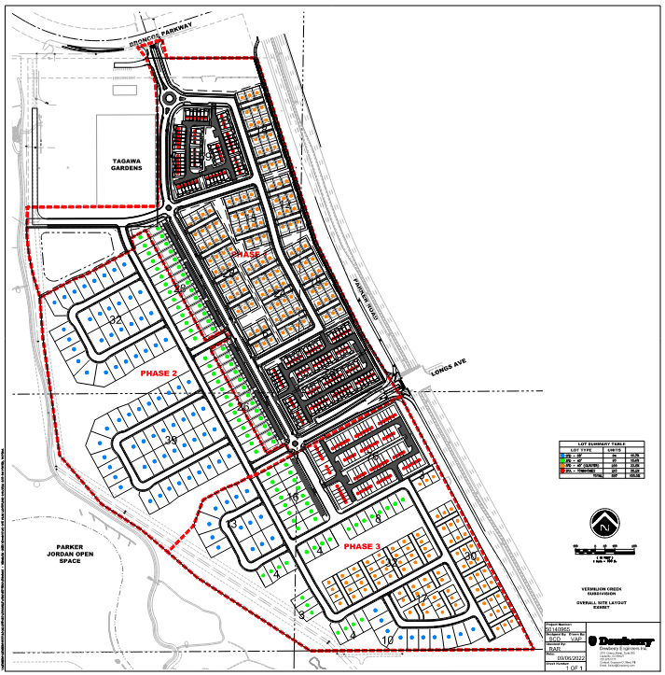
Site Plan:

Slide 8
Traffic, Parks. & Pedestrian Connectivity
The Vermilion Creek project is working with the City of Centennial very diligently to maximize pedestrian connectivity, enhance open spaces and parks (without forgetting about conserving water), and minimizing traffic impacts on the surrounding areas.
Traffic calming measures
Vermilion Creek’s development team has been working with the City of Centennial and is hoping to utilize one or more traffic calming measures such as round abouts, curb bump outs and 0 through streets to help slow down traffic and minimize cut through traffic from Broncos parkway and Parker Road.

Slide 9
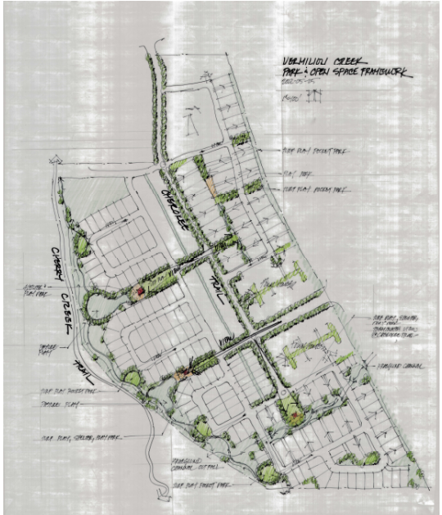
Open space and Parks
Open space above and beyond City of Centennial Requirements, with an emphasis on pedestrian connectivity and community enhancement.

Slide 10
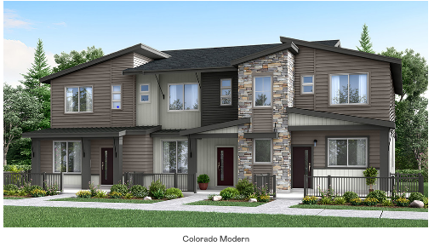
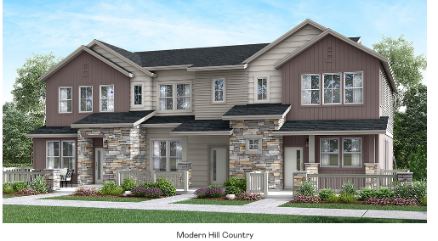
Architectural Styles (Note: final details to be worked through with Centennial)
Townhomes
All architectural materials, colors and styles including the amount of articulation, windows, brick, stone etc. are being worked through with the City of Centennial and will adhere to the Preliminary development Plan Amendment currently in process

Slide 11
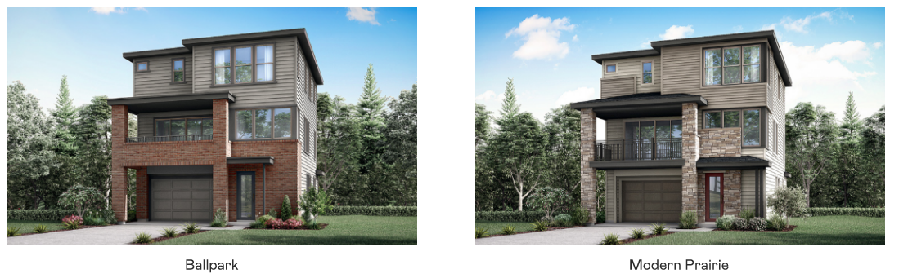
Architectural Styles (Note: final details to be worked through with Centennial more architectural styles may be used)
Cluster Homes

Slide 12
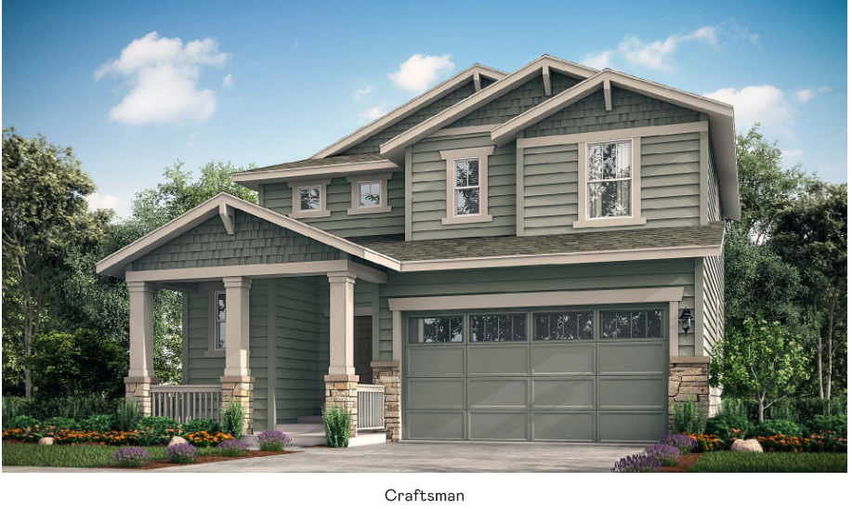
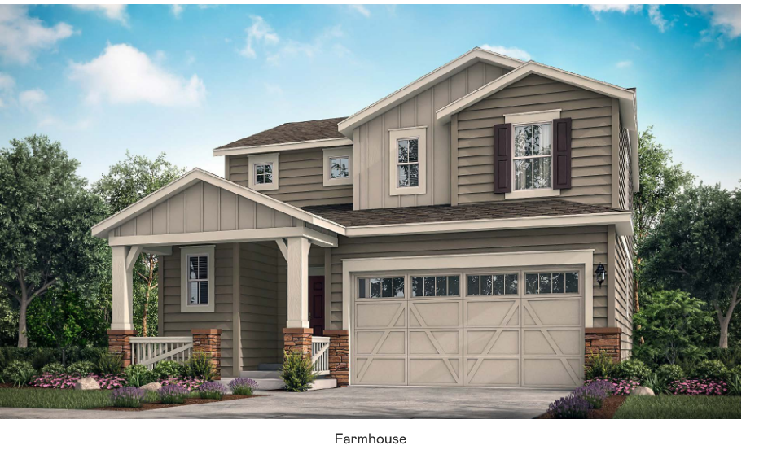
Architectural Styles (Note: final details to be worked through with Centennial more architectural styles may be used)
Small Lot Homes

Slide 13
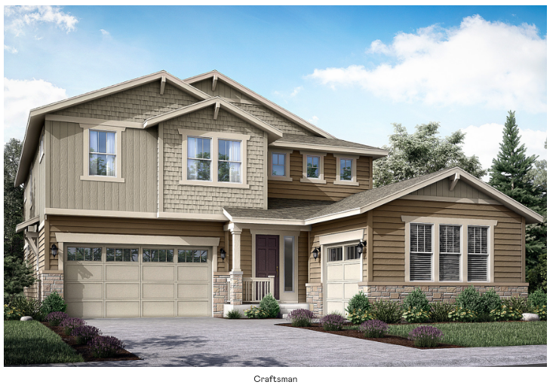
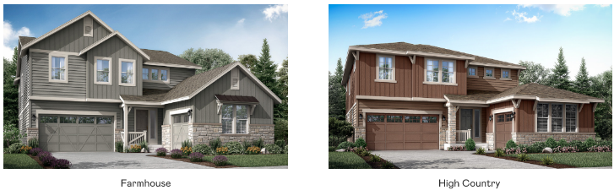
Architectural Styles (Note: final details to be worked through with Centennial more architectural styles may be used)
Large Lot Homes

Slide 14
Project Summary
approximately 600 residential units total plus a mixed use parcel to be determined, Phase I will be approximately 240.
Emphasis on pedestrian connectivity to Cherry Creek Trail.
Maximizing open space and parks within the site.
Enhancing interplay with neighboring amenities.
Creating a true ‘Place’ for people within Centennial to live and enjoy the benefits Colorado has to offer.

